Slide 1
CONTEXT AWARE IMAGE SEARCH Guided By: dr.Shailesh S Submitted by: Anjana Mahesh aesthetix edu tech

Slide 2
Content
1.Abstract
2.Introduction
3.Literature Review
4.Objectives
5.Module Description
6.Methodology
7.Architecture
8.Result Analysis
9.Future Scope
10.Conclusion

Slide 3
Abstract
This project enhances image search by integrating visual and textual data.
Using a pre-trained ResNet18 model for image features and SpaCy's NER for textual descriptions, we combine these features and index them with the FAISS library for efficient similarity searches.
This approach significantly improves search accuracy and relevance. Future work will focus on refining feature extraction and optimizing the search process.

Slide 4
INTRODUCTION
Effective image search is crucial for numerous applications, from digital libraries to e-commerce. Combining visual and textual data presents challenges, including extracting meaningful features and integrating them for accurate searches. This project aims to enhance image search capabilities by leveraging advanced feature extraction techniques and indexing methods to provide more relevant and accurate search results.

Slide 5
objectives
Extract meaningful features from images and text.
Combine these features for improved search results.
Utilize efficient indexing for fast retrieval.

Slide 6
Literature review
TITLE | AUTHORS | ADVANTAGES | DISADVANTAGES
Deep Visual-Semantic Alignments for Generating Image Descriptions | Andrej Karpathy, Fei-Fei Li | Uses a combination of Convolutional Neural Networks (CNNs) for image processing and Recurrent Neural Networks (RNNs) for text generation. | Lacks the ability to understand deeper contextual relationships beyond visual similarity.
Show, Attend and Tell: Neural Image Caption Generation with Visual Attention | Kelvin Xu, Jimmy Ba, Ryan Kiros, et al. | Introduces an attention mechanism that allows the model to focus on specific parts of an image when generating descriptions. | Can still miss subtle contextual details, leading to less accurate or relevant captions.
Multimodal Neural Machine Translation with Image Guidance | Desmond Elliott, Stella Frank, et al. | Combines text and image data to create more contextually aware translations. | The model's performance heavily relies on the availability and quality of the visual data.

Slide 7
Module description
Image Feature Extraction: Using ResNet18
Text Feature Extraction: Using NER
Feature Combination: Concatenation of image and text features
FAISS Indexing: Efficient storage and retrieval
Search Functionality: Handling diverse query types

Slide 8
methodology
Libraries
Models
SpaCy
PyTorch
FAISS
Pandas
Numpy
Matplotlib & PIL
ResNet18: Pre-trained convolutional neural network model used for extracting image features
SpaCy's NER: Utilized to extract meaningful entities from text descriptions, capturing the contextual information.

Slide 9
Architecture
Image dataset
Preprocessing
Text dataset
Feature Extraction
Feature combination
Indexing and Storage
Search Functionality
Similarity Search

Slide 10
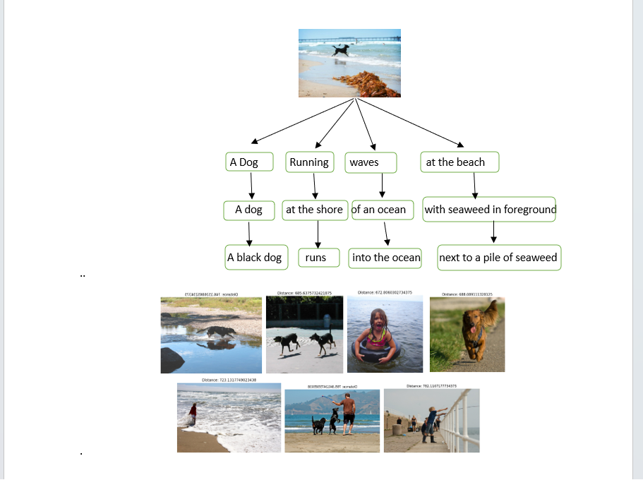
Result analysis

Slide 11
Analysis:
Enhanced search capabilities with combined features
Relevance and accuracy of retrieved images

Slide 12
Conclusion
Summary:
Successful integration of image and text features
Enhanced search capabilities demonstrated
Key Takeaways:
Importance of combined features in improving search accuracy
Potential for further improvements and applications

Slide 13
Thank you

